Slide 1
// include/linux/cdev.h
struct cdev {
struct kobject kobj;
struct module *owner;
const struct file_operations *ops;
struct list_head list;
dev_t dev;
unsigned int count;
} __randomize_layout;
// rust/bindings/bindings_helper.h
#include <linux/cdev.h>
// rust/bindings/bindings_generated.rs
#[repr(C)]
#[derive(Copy, Clone)]
pub struct cdev {
pub kobj: kobject,
pub owner: *mut module,
pub ops: *const file_operations,
pub list: list_head,
pub dev: dev_t,
pub count: core::ffi::c_uint,
}
// rust/kernel/chrdev.rs
/// Character device.
///
/// # Invariants
/// - [`self.0`] is valid and non-null.
struct Cdev(*mut bindings::cdev);
struct RegistrationInner<const N: usize> {
cdevs: [Option<Cdev>; N],
}
pub struct Registration<const N: usize> {
inner: Option<RegistrationInner<N>>,
}
impl Cdev {
fn alloc(……) -> Result<Self> {
// SAFETY: FFI call.
let c=unsafe{bindings::cdev_alloc()};
}
// rust/kernel/driver.rs pub trait DriverOps {
/// # Safety
/// `reg` must point to valid, initialised, and writable memory.
unsafe fn register(
reg: *mut Self::RegType,…) -> Result;
}
// samples/rust/rust_chrdev.rs
module! {
type: RustChrdev,
name: "rust_chrdev",
author: "Rust for Linux Contributors",
}
struct RustFile;
struct RustChrdev {
_dev: Pin<Box<chrdev::Registration<2>>>,
}
impl kernel::Module for RustChrdev {
fn init(……) -> Result<Self> { let mut chr = chrdev::Registration::new_pinned(……)?;
chr.as_mut().register::<RustFile>()?;
Ok(RustChrdev { _dev: chr })
}
}
impl Drop for RustChrdev {
fn drop(&mut self) {……}
}
(a)
(b)
(c)

Slide 2
// In C
struct elements {
int len; void* inner;
}; struct factory {
struct elements factory_inner;
};
struct factory thread_thread = {
.factory_inner = {
.len = 256, .inner = thread_ptr }
};
struct factory proxy_thread = {
.factory_inner = {
.len = 256, .inner = proxy_ptr }}
;
// In Rust
pub struct elements<const N: usize> {
inner: [i32; N],
} pub struct factory {
factory_inner: elements<8/256>,
}
let thread_factory = factory { factory_inner:
elements::< 8/256 > { inner: [0; 8/256] } }; let proxy_factory = factory { factory_inner:
elements::< 8/256 > { inner: [0; 8/256] } };
// In Rust but inflexible
pub struct elements<const N: usize> {
inner: [i32; N],
} trait dyn_num { // fn use_elements(&self); } pub struct factory {
factory_inner: &'static dyn dyn_num
}
struct thread<const T: usize>{
thread_elements: elements<T>,
} impl dyn_num for thread<256> {}
struct proxy<const T: usize>{
proxy_elements: elements<T>,
} impl dyn_num for proxy<8> {}
static thread_factory_inner: thread<256> = thread {
thread_elements: elements { inner: [0; 256] },
}; static proxy_factory_inner: proxy<8> = proxy {
proxy_elements: elements { inner: [1; 8] },
};
let thread_factory = factory { factory_inner:
&thread_factory_inner }; let proxy_factory = factory {factory_inner:
&proxy_factory_inner };
(a)
(b)

Slide 3
Study the RFL codes
Collect discussions and presentations
Analyze RFL issues and BUGs
Find RFL Linux kernel drivers

Slide 4
Collect and study RFL related data and materials
RQ1: What’s the status quo of RFL?
RQ2: Does RFL live up to the hype?
RQ3:Where the RFL will go in next?

Slide 5
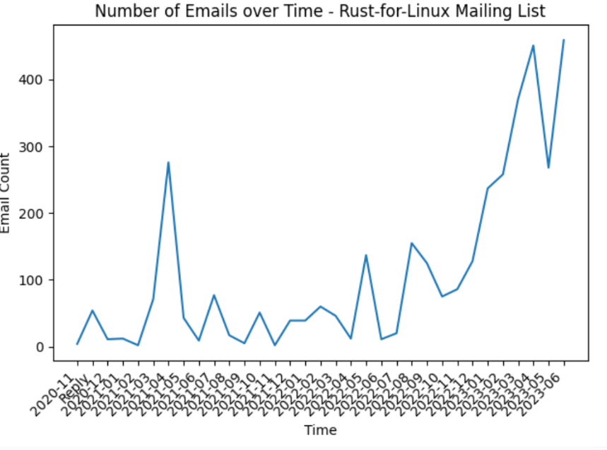
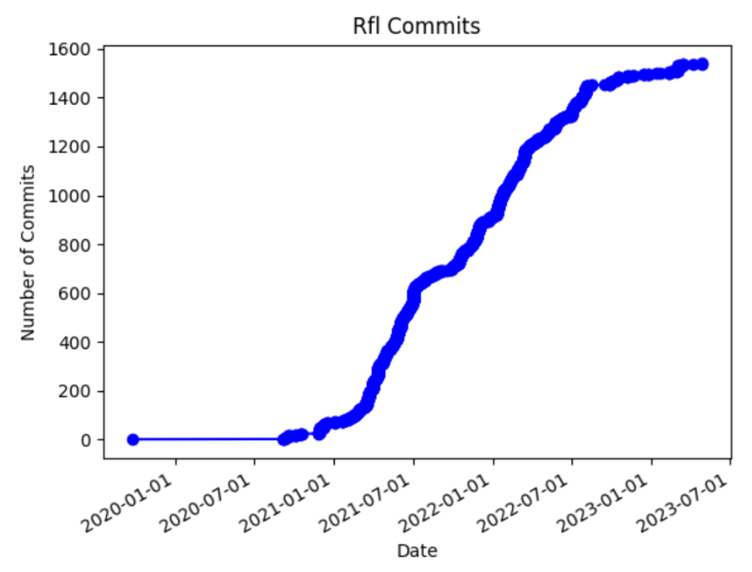
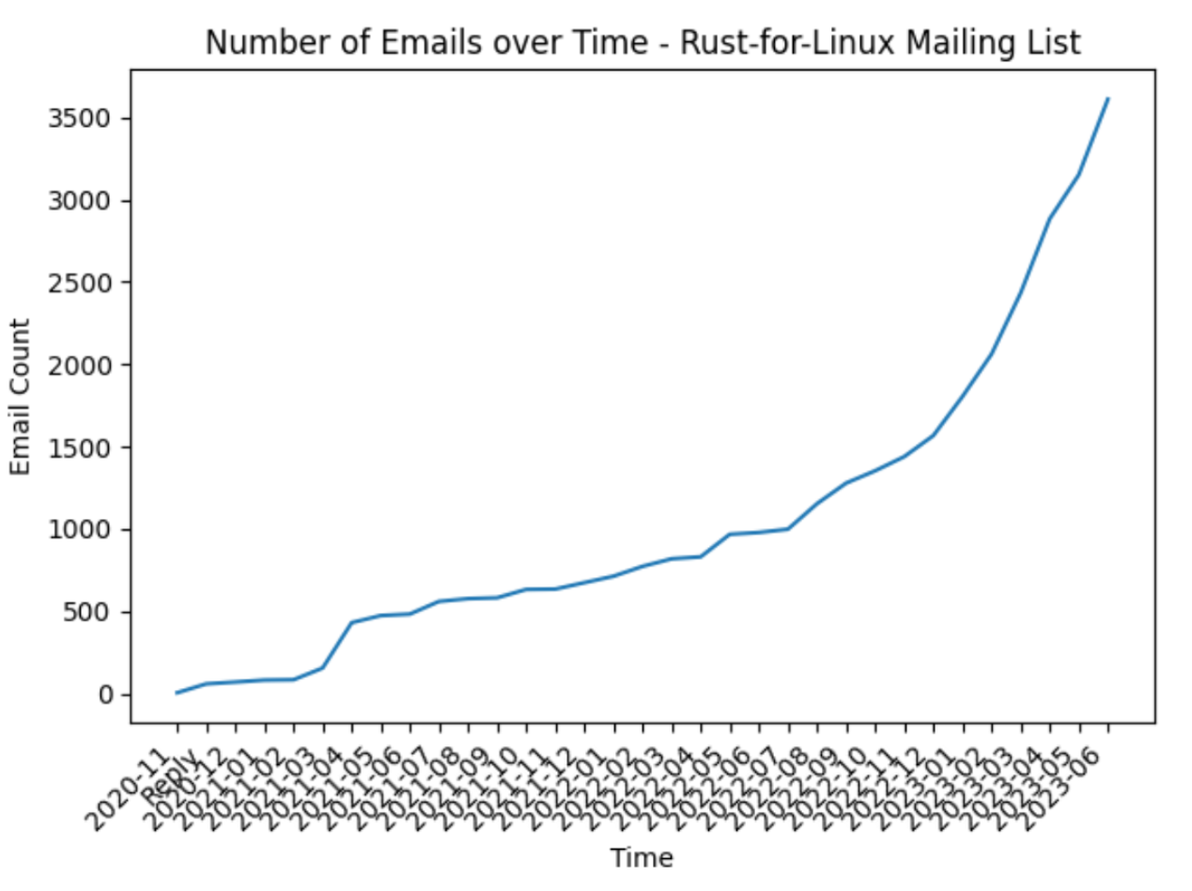
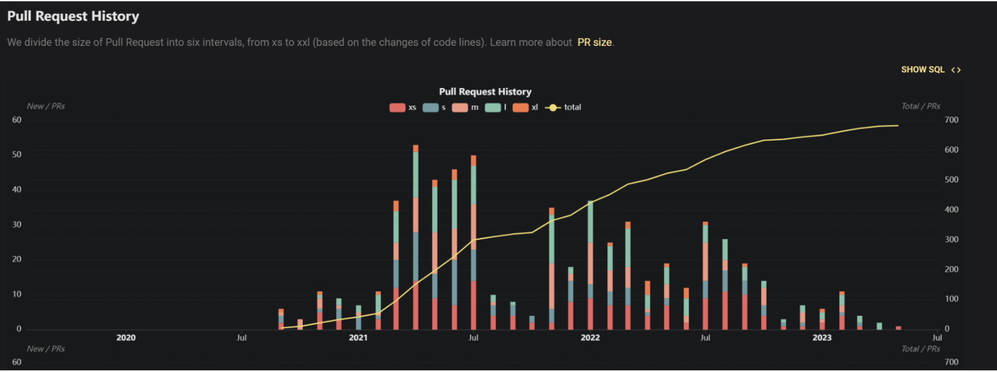
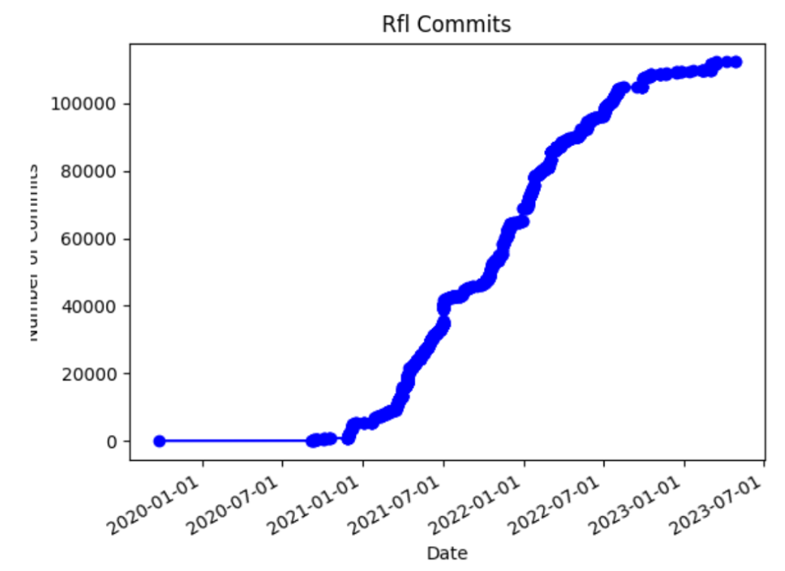
Sum of # 还是直接的 #
CoL
PR和社区的email肯定有重合 这个怎么说明

Slide 6
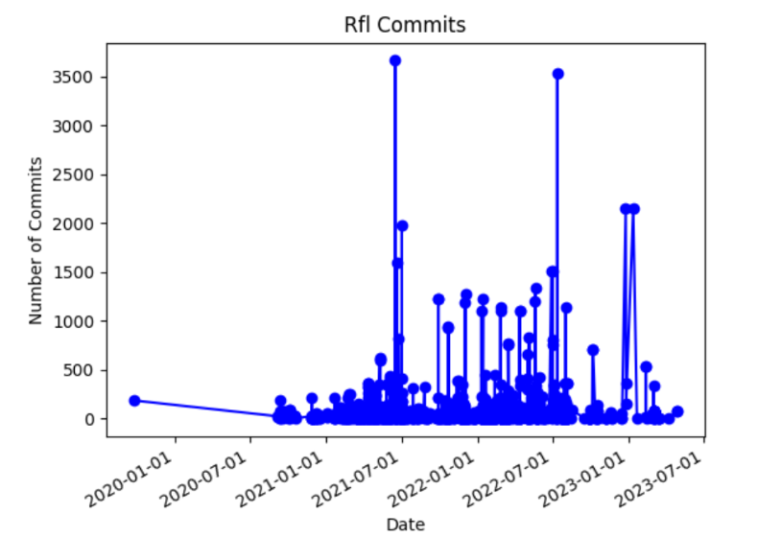
Sum of # 还是直接的 #
CoL
PR和社区的email肯定有重合 这个怎么说明

Slide 7
Sum of # 还是直接的 #
CoL
PR和社区的email肯定有重合 这个怎么说明

Slide 8
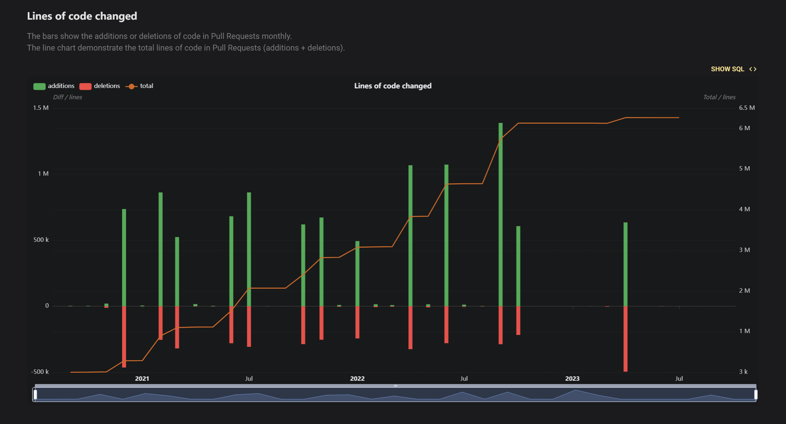
Sum of # 还是直接的 #
CoL
PR和社区的email肯定有重合 这个怎么说明

Slide 9
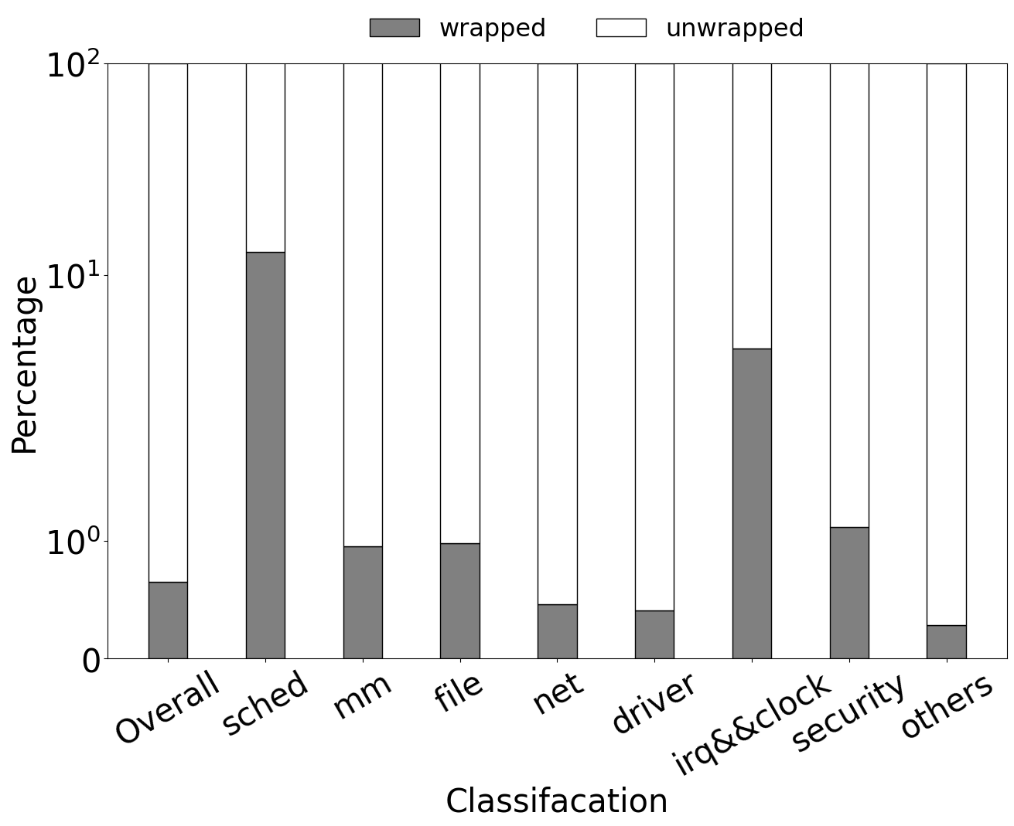
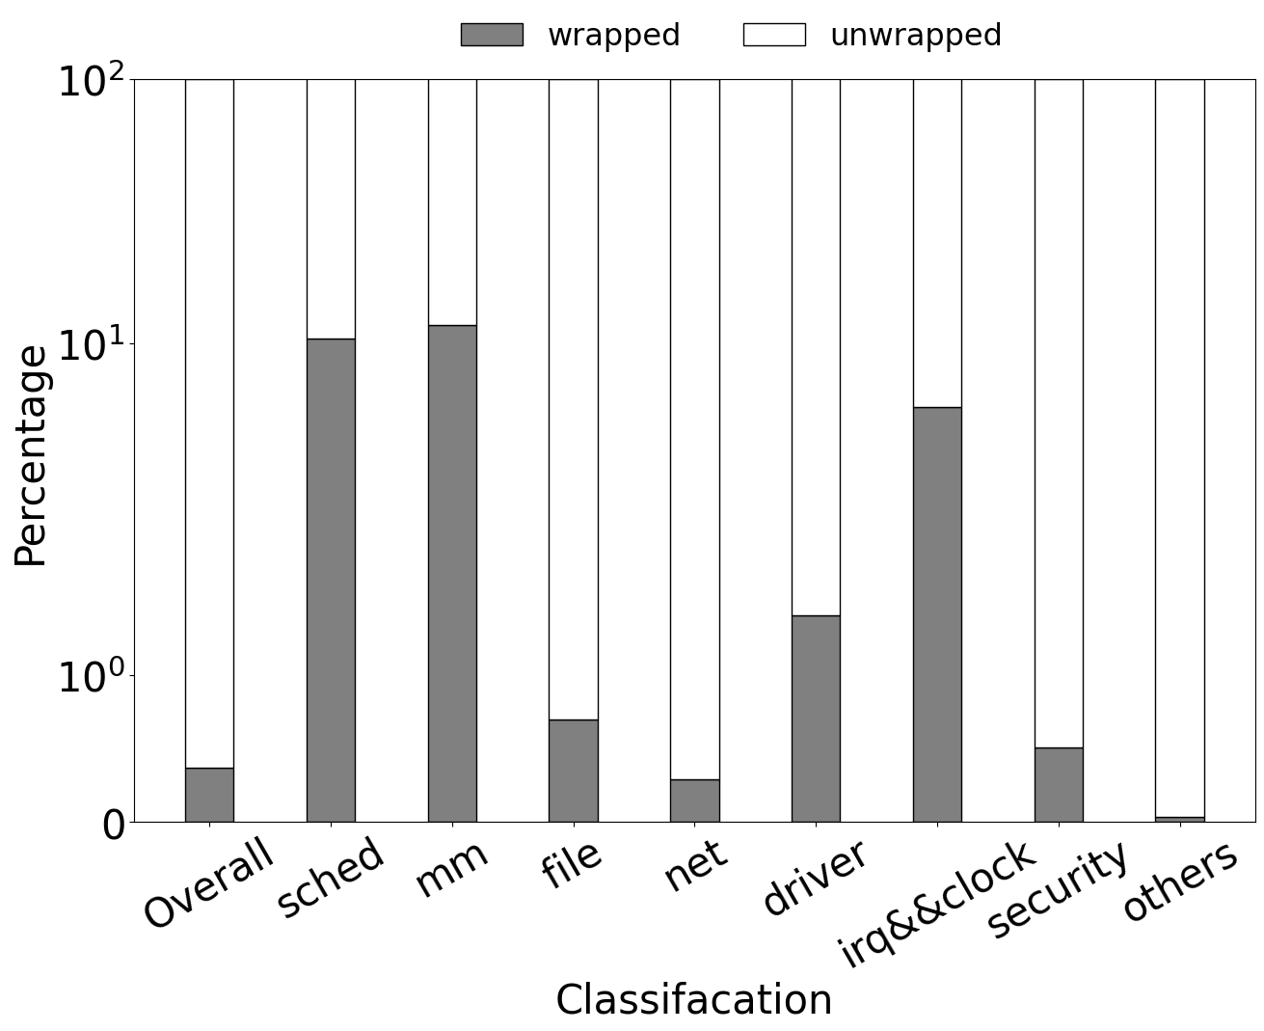
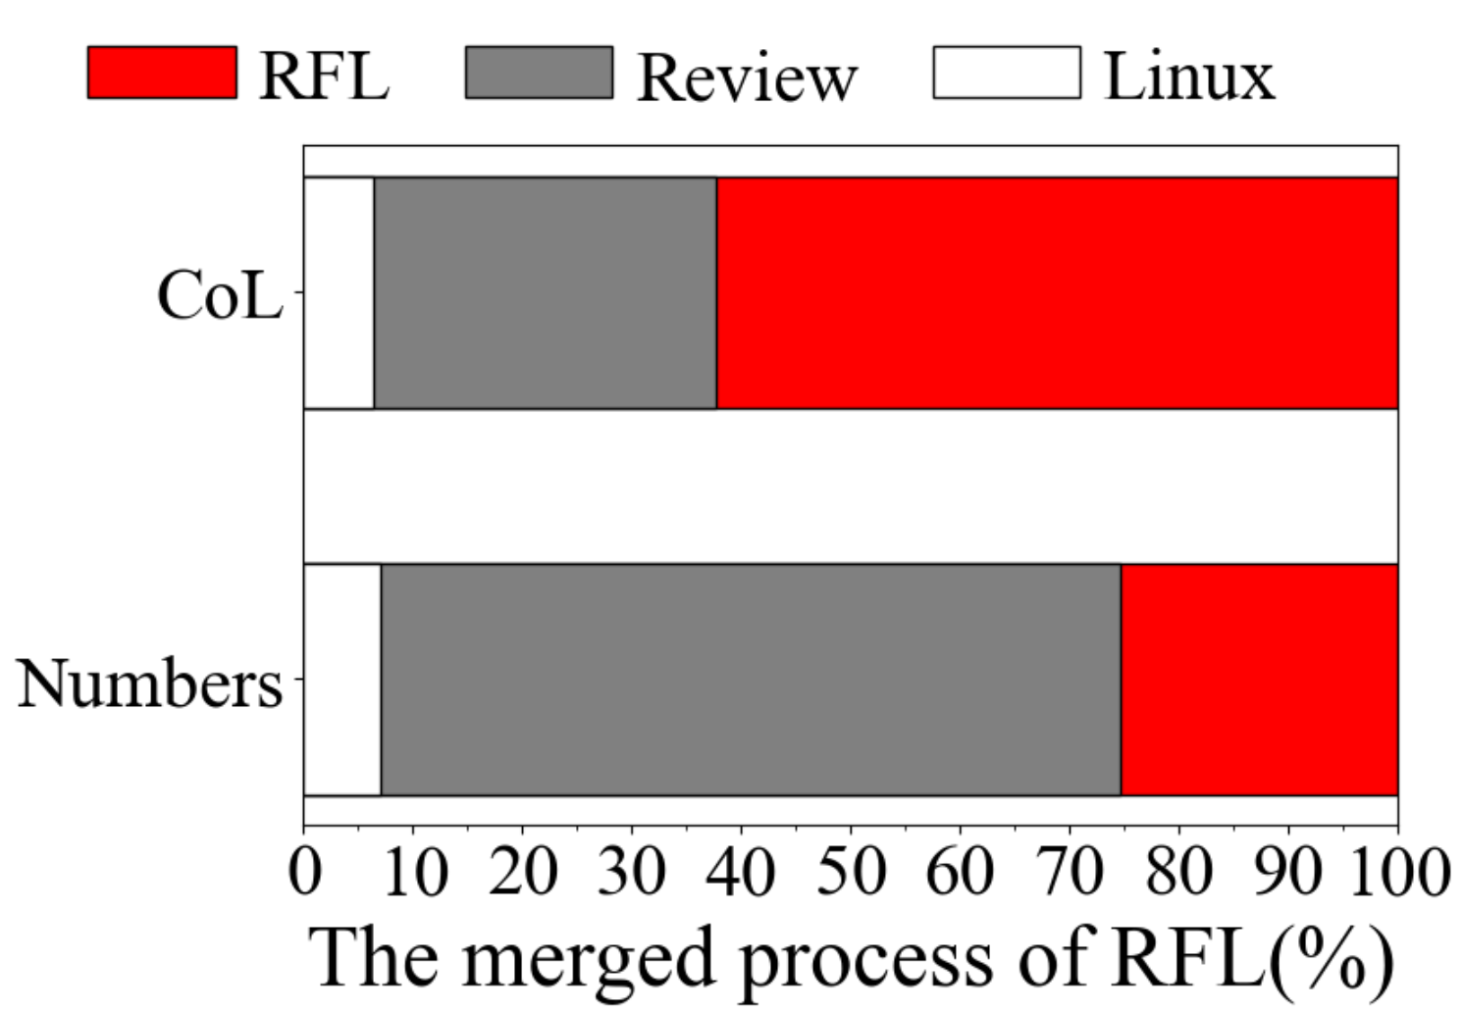
7.1%
37.6%
6.4%
74.6%
(a) The progress of the wrapped struts
(b) The progress of the wrapped functions
(c) The progress of the wrapped struts

Slide 10
7.1%
37.6%
6.4%
74.6%
(a) The progress of the wrapped struts
(b) The progress of the wrapped functions
(c) The progress of the wrapped struts

Slide 11
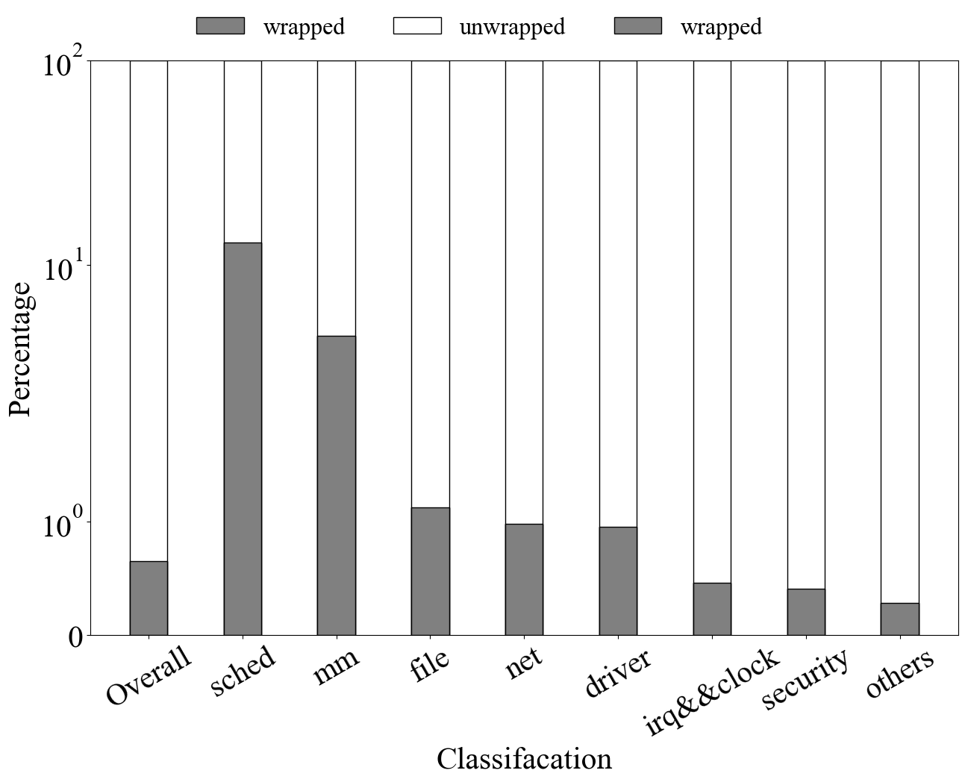
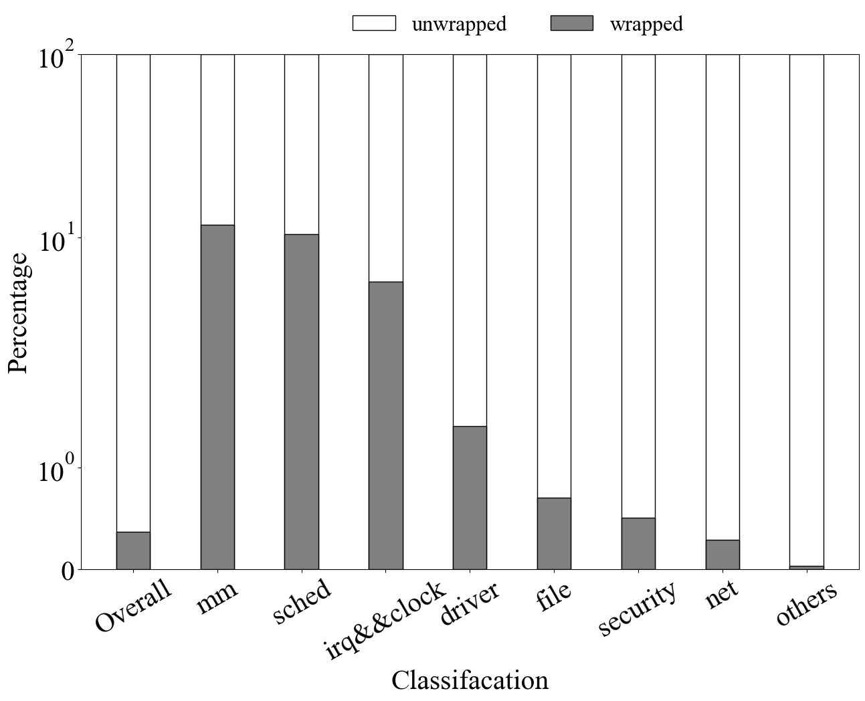
7.1%
37.6%
6.4%
74.6%
(a) The progress of the wrapped struts
(b) The progress of the wrapped functions
(c) The progress of the wrapped struts

Slide 12
7.1%
37.6%
6.4%
74.6%
(a) The progress of the wrapped struts
(b) The progress of the wrapped functions
(c) The progress of the wrapped struts

Slide 13
7.1%
37.6%
6.4%
74.6%
(a) The merged progress of RFL
(b) The progress of the wrapped functions
(c) The progress of the wrapped struts
(c) The progress of the wrapped struts

Slide 14
7.1%
37.6%
6.4%
74.6%
(a) The progress of the wrapped struts
(b) The progress of the wrapped functions
(c) The progress of the wrapped struts

Slide 15
7.1%
37.6%
6.4%
74.6%
(a) The progress of the wrapped struts
(b) The progress of the wrapped functions
(c) The progress of the wrapped struts

Slide 16
7.1%
37.6%
6.4%
74.6%

Slide 18
RQ1: What’s the status quo of RFL?
Data structers
RQ3:Where the RFL will go in next?

Slide 20
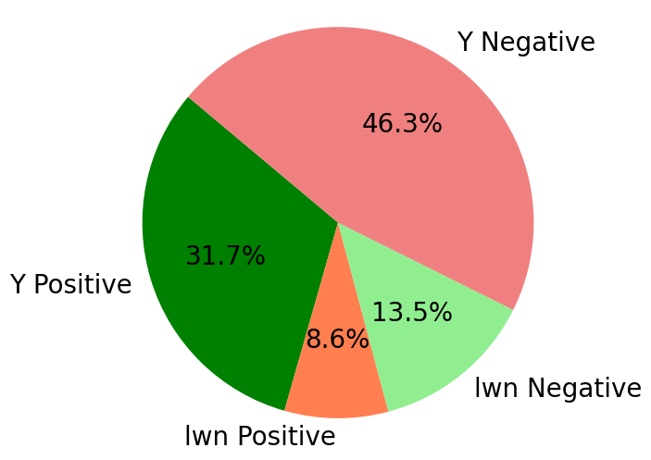
Top5 of Positive reasons:
Safety and Memory Safety
Compatibility and Integration
Performance and Efficiency
Code Quality and Standards
Expressiveness and Features
Top5 of Negative reasons:
Learning Curve and Complexity
Kernel Compatibility
Resource Allocation
Developer Sentiment
Advocacy and Hype
(a) The percentage of different opinions
(b) The specific reasons

Slide 21
Top5 of Positive reasons:
Safety and Memory Safety
Compatibility and Integration
Performance and Efficiency
Code Quality and Standards
Expressiveness and Features
Top5 of Negative reasons:
Learning Curve and Complexity
Kernel Compatibility
Resource Allocation
Developer Sentiment
Advocacy and Hype

Slide 23
290
290
2013 Taesoo Kim started to use Rust writing Linux kernel drivers
2021 Miguel Ojeda gave an RFL RFC in the mailing list
290
2020 Nick started a session in LPC to bring attention from the community
290
2020 The first PR of RFL was committed by Miguel Ojeda on the GitHub
290
290
2019 Alex and Thomas presented the linux-kernel-module-rust project
2022 RFL was merged into the Linux mainline in 6.1

Slide 24
290
290
2013 First project started to use Rust writing Linux kernel drivers
2021 Miguel Ojeda gave an RFL RFC in the mailing list
290
2020 A session in LPC to bring attention from the community
290
2020 The first PR of RFL was committed by Miguel Ojeda on the GitHub
290
290
2019 Alex and Thomas presented the linux-kernel-module-rust project
2022 RFL was merged into the Linux mainline in 6.1

Slide 25
290
290
2013.5 First project started to use Rust writing Linux kernel drivers
2021.12 First RFC of RFL in the mailing list
290
2020.8 First session in LPC to bring attention from the community
290
2020.9 First PR of RFL was committed on the GitHub
290c
2022.10 RFL was merged into the Linux mainline in 6.1
290c
2019.10 First public presentation of the linux-kernel-module-rust project

Slide 26
290
290
2013 First project started to use Rust writing Linux kernel drivers
2021 First RFC of RFL in the mailing list
290
2020 First session in LPC to bring attention from the community
290
2020 First PR of RFL was committed on the GitHub
290
290
2019 First public presentation of the linux-kernel-module-rust project
2022 RFL was merged into the Linux mainline in 6.1

Slide 28
// include/linux/cdev.h
struct cdev {
struct kobject kobj;
struct module *owner;
const struct file_operations *ops;
struct list_head list;
dev_t dev;
unsigned int count;
} __randomize_layout;
// rust/bindings/bindings_helper.h
#include <linux/cdev.h>
// rust/bindings/bindings_generated.rs
#[repr(C)]
#[derive(Copy, Clone)]
pub struct cdev {
pub kobj: kobject,
pub owner: *mut module,
pub ops: *const file_operations,
pub list: list_head,
pub dev: dev_t,
pub count: core::ffi::c_uint,
}
// rust/kernel/chrdev.rs
/// Character device.
///
/// # Invariants
/// - [`self.0`] is valid and non-null.
struct Cdev(*mut bindings::cdev);
struct RegistrationInner<const N: usize> {
cdevs: [Option<Cdev>; N],
}
pub struct Registration<const N: usize> {
inner: Option<RegistrationInner<N>>,
}
impl Cdev {
fn alloc(……) -> Result<Self> {
// SAFETY: FFI call.
let c=unsafe{bindings::cdev_alloc()};
}
// rust/kernel/driver.rs pub trait DriverOps {
/// # Safety
/// `reg` must point to valid, initialised, and writable memory.
unsafe fn register(
reg: *mut Self::RegType,…) -> Result;
}
// samples/rust/rust_chrdev.rs
module! {
type: RustChrdev,
name: "rust_chrdev",
author: "Rust for Linux Contributors",
}
struct RustFile;
struct RustChrdev {
_dev: Pin<Box<chrdev::Registration<2>>>,
}
impl kernel::Module for RustChrdev {
fn init(……) -> Result<Self> { let mut chr = chrdev::Registration::new_pinned(……)?;
chr.as_mut().register::<RustFile>()?;
Ok(RustChrdev { _dev: chr })
}
}
impl Drop for RustChrdev {
fn drop(&mut self) {……}
}
(a)
(b)
(c)

Slide 30



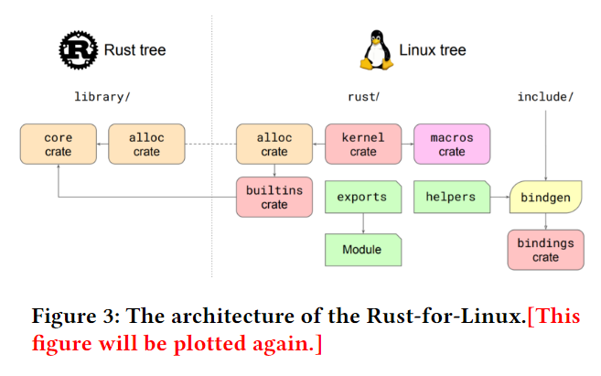



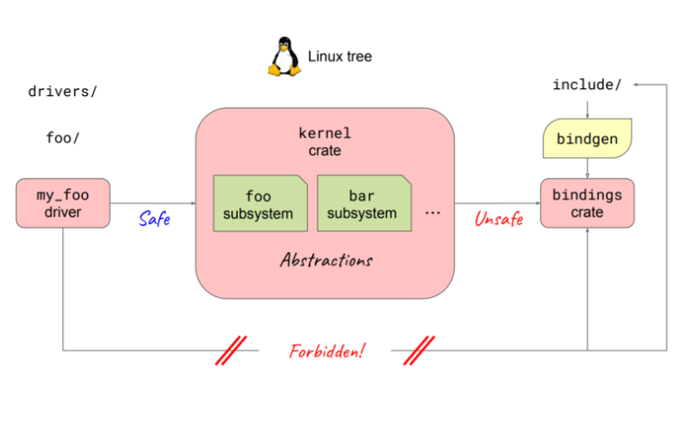
rust/bindings/
bindings_generated.rs
R
#[repr(C)]
#[derive(Copy, Clone)]
pub struct cdev {
……
}
make LLVM=1 -j
Bindings crate
samples/rust/rust_chrdev.rs
R
#[repr(C)]
#[derive(Copy, Clone)]
pub struct cdev {
……
}
make LLVM=1 -j
C
struct cdev {
……
} __randomize_layout;
include/linux/cdev.h
R
pub struct Box<T: ?Sized, A: Allocator = Global,
>(Unique<T>, A);
R
R
RFL
modify
pub struct Vec<T, A: Allocator = Global> {
buf: RawVec<T, A>,
len: usize,
}
alloc crate
kernel crate
drivers crate
Rust-Code
Tree
// rust/kernel/chrdev.rs
/// Character device.
///
/// # Invariants
/// - [`self.0`] is valid and non-null.
struct Cdev(*mut bindings::cdev);
struct RegistrationInner<const N: usize> {
cdevs: [Option<Cdev>; N],
}
pub struct Registration<const N: usize> {
inner: Option<RegistrationInner<N>>,
}
impl Cdev {
fn alloc(……) -> Result<Self> {
// SAFETY: FFI call.
let c=unsafe{bindings::cdev_alloc()};
}
// rust/kernel/driver.rs pub trait DriverOps {
/// # Safety
/// `reg` must point to valid, initialised, and writable memory.
unsafe fn register(
reg: *mut Self::RegType,…) -> Result;
}
R
pub struct PhantomData<T: ?Sized>;
Use
Directly
pub struct UnsafeCell<T: ?Sized> {
value: T,
}
// samples/rust/rust_chrdev.rs
module! {
type: RustChrdev,
name: "rust_chrdev",
author: "Rust for Linux Contributors",
}
struct RustFile;
struct RustChrdev {
_dev: Pin<Box<chrdev::Registration<2>>>,
}
impl kernel::Module for RustChrdev {
fn init(……) -> Result<Self> { let mut chr = chrdev::Registration::new_pinned(……)?;
chr.as_mut().register::<RustFile>()?;
Ok(RustChrdev { _dev: chr })
}
}
impl Drop for RustChrdev {
fn drop(&mut self) {……}
}
core crate
C
#include <linux/cdev.h>
R
pub fn module(ts: TokenStream) -> TokenStream {
module::module(ts)
}
bindings_helper.h
macro crate
Rust
bindgen
Linux-
Code
Tree
R
#[repr(C)]
#[derive(Copy, Clone)]
pub struct cdev {
……
}
bindings crate
C
struct cdev {
……
} __randomize_layout;
Unsafe
Only Safe
R
macro_rules!
define_panicking_intrinsics (
……
);
include/linux/cdev.h
builtin crate
R
Bindings crate
Bindings crate
R
#[repr(C)]
#[derive(Copy, Clone)]
pub struct cdev {
……
}
Rust
bindgen

Slide 31
rust/bindings/
bindings_generated.rs
R
#[repr(C)]
#[derive(Copy, Clone)]
pub struct cdev {
……
}
make LLVM=1 -j
Bindings crate
samples/rust/rust_chrdev.rs
R
#[repr(C)]
#[derive(Copy, Clone)]
pub struct cdev {
……
}
make LLVM=1 -j
C
struct cdev {
……
} __randomize_layout;
include/linux/cdev.h
R
pub struct Box<T: ?Sized, A: Allocator = Global,
>(Unique<T>, A);
R
R
RFL
modify
pub struct Vec<T, A: Allocator = Global> {
buf: RawVec<T, A>,
len: usize,
}
alloc crate
kernel crate
drivers crate
Rust-Code
Tree
// rust/kernel/chrdev.rs
/// Character device.
///
/// # Invariants
/// - [`self.0`] is valid and non-null.
struct Cdev(*mut bindings::cdev);
struct RegistrationInner<const N: usize> {
cdevs: [Option<Cdev>; N],
}
pub struct Registration<const N: usize> {
inner: Option<RegistrationInner<N>>,
}
impl Cdev {
fn alloc(……) -> Result<Self> {
// SAFETY: FFI call.
let c=unsafe{bindings::cdev_alloc()};
}
// rust/kernel/driver.rs pub trait DriverOps {
/// # Safety
/// `reg` must point to valid, initialised, and writable memory.
unsafe fn register(
reg: *mut Self::RegType,…) -> Result;
}
R
pub struct PhantomData<T: ?Sized>;
Use
Directly
pub struct UnsafeCell<T: ?Sized> {
value: T,
}
// samples/rust/rust_chrdev.rs
module! {
type: RustChrdev,
name: "rust_chrdev",
author: "Rust for Linux Contributors",
}
struct RustFile;
struct RustChrdev {
_dev: Pin<Box<chrdev::Registration<2>>>,
}
impl kernel::Module for RustChrdev {
fn init(……) -> Result<Self> { let mut chr = chrdev::Registration::new_pinned(……)?;
chr.as_mut().register::<RustFile>()?;
Ok(RustChrdev { _dev: chr })
}
}
impl Drop for RustChrdev {
fn drop(&mut self) {……}
}
core crate
C
#include <linux/cdev.h>
R
pub fn module(ts: TokenStream) -> TokenStream {
module::module(ts)
}
bindings_helper.h
macro crate
Rust
bindgen
#[repr(C)]
#[derive(Copy, Clone)]
pub struct cdev {
……
}
Linux-
Code
Tree
R
bindings crate
C
struct cdev {
……
} __randomize_layout;
Unsafe
Only Safe
R
macro_rules!
define_panicking_intrinsics (
……
);
include/linux/cdev.h
builtin crate
R
Bindings crate
Bindings crate
R
#[repr(C)]
#[derive(Copy, Clone)]
pub struct cdev {
……
}
Rust
bindgen

Slide 32
rust/bindings/
bindings_generated.rs
R
#[repr(C)]
#[derive(Copy, Clone)]
pub struct cdev {
……
}
make LLVM=1 -j
Bindings crate
samples/rust/rust_chrdev.rs
R
#[repr(C)]
#[derive(Copy, Clone)]
pub struct cdev {
……
}
make LLVM=1 -j
C
struct cdev {
……
} __randomize_layout;
include/linux/cdev.h
R
pub struct Box<T: ?Sized, A: Allocator = Global,
>(Unique<T>, A);
R
R
RFL
modify
pub struct Vec<T, A: Allocator = Global> {
buf: RawVec<T, A>,
len: usize,
}
alloc crate
kernel crate
drivers crate
Rust-Code
Tree
// rust/kernel/chrdev.rs
/// Character device.
///
/// # Invariants
/// - [`self.0`] is valid and non-null.
struct Cdev(*mut bindings::cdev);
struct RegistrationInner<const N: usize> {
cdevs: [Option<Cdev>; N],
}
pub struct Registration<const N: usize> {
inner: Option<RegistrationInner<N>>,
}
impl Cdev {
fn alloc(……) -> Result<Self> {
// SAFETY: FFI call.
let c=unsafe{bindings::cdev_alloc()};
}
// rust/kernel/driver.rs pub trait DriverOps {
/// # Safety
/// `reg` must point to valid, initialised, and writable memory.
unsafe fn register(
reg: *mut Self::RegType,…) -> Result;
}
R
pub struct PhantomData<T: ?Sized>;
Use
Directly
pub struct UnsafeCell<T: ?Sized> {
value: T,
}
// samples/rust/rust_chrdev.rs
module! {
type: RustChrdev,
name: "rust_chrdev",
author: "Rust for Linux Contributors",
}
struct RustFile;
struct RustChrdev {
_dev: Pin<Box<chrdev::Registration<2>>>,
}
impl kernel::Module for RustChrdev {
fn init(……) -> Result<Self> { let mut chr = chrdev::Registration::new_pinned(……)?;
chr.as_mut().register::<RustFile>()?;
Ok(RustChrdev { _dev: chr })
}
}
impl Drop for RustChrdev {
fn drop(&mut self) {……}
}
core crate
C
pub fn module(ts: TokenStream) -> TokenStream {
module::module(ts)
}
#include <linux/cdev.h>
R
bindings_helper.h
macro crate
Rust
bindgen
#[repr(C)]
#[derive(Copy, Clone)]
pub struct cdev {
……
}
Linux-
Code
Tree
R
bindings crate
C
struct cdev {
……
} __randomize_layout;
Unsafe
Only Safe
R
macro_rules!
define_panicking_intrinsics (
……
);
include/linux/cdev.h
builtin crate
(a)
(b)
(c)
R
Bindings crate
Bindings crate
R
#[repr(C)]
#[derive(Copy, Clone)]
pub struct cdev {
……
}
Rust
bindgen

Slide 33
rust/bindings/
bindings_generated.rs
R
#[repr(C)]
#[derive(Copy, Clone)]
pub struct cdev {
……
}
make LLVM=1 -j
Bindings crate
samples/rust/rust_chrdev.rs
R
#[repr(C)]
#[derive(Copy, Clone)]
pub struct cdev {
……
}
make LLVM=1 -j
C
struct cdev {
……
} __randomize_layout;
include/linux/cdev.h
R
pub struct Box<T: ?Sized, A: Allocator = Global,
>(Unique<T>, A);
R
R
RFL
modify
pub struct Vec<T, A: Allocator = Global> {
buf: RawVec<T, A>,
len: usize,
}
alloc crate
kernel crate
drivers crate
Rust-Code
Tree
// rust/kernel/chrdev.rs
/// Character device.
///
/// # Invariants
/// - [`self.0`] is valid and non-null.
struct Cdev(*mut bindings::cdev);
struct RegistrationInner<const N: usize> {
cdevs: [Option<Cdev>; N],
}
pub struct Registration<const N: usize> {
inner: Option<RegistrationInner<N>>,
}
impl Cdev {
fn alloc(……) -> Result<Self> {
// SAFETY: FFI call.
let c=unsafe{bindings::cdev_alloc()};
}
// rust/kernel/driver.rs pub trait DriverOps {
/// # Safety
/// `reg` must point to valid, initialised, and writable memory.
unsafe fn register(
reg: *mut Self::RegType,…) -> Result;
}
R
pub struct PhantomData<T: ?Sized>;
Use
Directly
pub struct UnsafeCell<T: ?Sized> {
value: T,
}
// samples/rust/rust_chrdev.rs
module! {
type: RustChrdev,
name: "rust_chrdev",
author: "Rust for Linux Contributors",
}
struct RustFile;
struct RustChrdev {
_dev: Pin<Box<chrdev::Registration<2>>>,
}
impl kernel::Module for RustChrdev {
fn init(……) -> Result<Self> { let mut chr = chrdev::Registration::new_pinned(……)?;
chr.as_mut().register::<RustFile>()?;
Ok(RustChrdev { _dev: chr })
}
}
impl Drop for RustChrdev {
fn drop(&mut self) {……}
}
core crate
C
pub fn module(ts: TokenStream) -> TokenStream {
module::module(ts)
}
#include <linux/cdev.h>
R
bindings_helper.h
macro crate
Rust
bindgen
#[repr(C)]
#[derive(Copy, Clone)]
pub struct cdev {
……
}
Linux-
Code
Tree
R
bindings crate
C
struct cdev {
……
} __randomize_layout;
Unsafe
Only Safe
R
macro_rules!
define_panicking_intrinsics (
……
);
include/linux/cdev.h
builtin crate
(a)
(b)
(c)
R
Bindings crate
Bindings crate
R
#[repr(C)]
#[derive(Copy, Clone)]
pub struct cdev {
……
}
Rust
bindgen

Slide 35
struct ConNum{inner: Mutex<i32>}
static num: ConNum = ConNum::new(0);
fn main() {
let n1 = ConNum::new(2023);
let n2 = n1;
println!("n2 is {}", *n2.inner.lock().unwrap());
// println!("n1 is {}", *n1.inner.lock().unwrap()); ownership+move: n1 is moved to n2 // let n3 = 2023 as ConNum; strict typed: i32 and ConNum are different types
let res = thread::spawn(|| {
for _ in 0..1000000 {
// let inner = num.inner.lock().unwrap(); mutability: inner need to be mutable to self-add
let mut inner = num.inner.lock().unwrap(); // mutability+borrow: immutable reference
*inner += 1;
// println!("n2 is {}", *n2.inner.lock().unwrap()); lifetime: lifetime of n2 maybe short than this thread
}
}); for _ in 0..1000000 {
let mut inner = num.inner.lock().unwrap(); // mutability+borrow: immutable reference
*inner += 1;
};
println!("num is {}", *num.inner.lock().unwrap()); // 2000000
}
// rust/kernel/chrdev.rs
/// Character device.
///
/// # Invariants
/// - [`self.0`] is valid and non-null.
struct Cdev(*mut bindings::cdev);
struct RegistrationInner<const N: usize> {
cdevs: [Option<Cdev>; N],
}
pub struct Registration<const N: usize> {
inner: Option<RegistrationInner<N>>,
}
impl Cdev {
fn alloc(……) -> Result<Self> {
// SAFETY: FFI call.
let c=unsafe{bindings::cdev_alloc()};
}
// rust/kernel/driver.rs pub trait DriverOps {
/// # Safety
/// `reg` must point to valid, initialised, and writable memory.
unsafe fn register(
reg: *mut Self::RegType,…) -> Result;
}
// samples/rust/rust_chrdev.rs
module! {
type: RustChrdev,
name: "rust_chrdev",
author: "Rust for Linux Contributors",
}
struct RustFile;
struct RustChrdev {
_dev: Pin<Box<chrdev::Registration<2>>>,
}
impl kernel::Module for RustChrdev {
fn init(……) -> Result<Self> { let mut chr = chrdev::Registration::new_pinned(……)?;
chr.as_mut().register::<RustFile>()?;
Ok(RustChrdev { _dev: chr })
}
}
impl Drop for RustChrdev {
fn drop(&mut self) {……}
}
(a)
(b)
(c)

Slide 36
struct ConNum{inner: Mutex<i32>}
unsafe impl Send for ConNum {} // send: mutex ensures this
unsafe impl Sync for ConNum {} // sync: mutex ensures this
struct LinkedNode<'a> {
prev: Option<&'a mut LinkedNode<'a>>,
next: Option<&'a mut LinkedNode<'a>>,
}
static num: ConNum = ConNum::new(0);
fn main() {
let n1 = ConNum::new(2023);
let n2 = n1;
println!("n2 is {}", *n2.inner.lock().unwrap());
// println!("n1 is {}", *n1.inner.lock().unwrap()); ownership+move: n1 is moved to n2
// let n3 = 2023 as ConNum; strict typed: i32 and ConNum are different types
let mut ln1 = LinkedNode::new(); let mut ln2 = LinkedNode::new(); let mut ln3 = LinkedNode::new();
// ln1.next = Some(&mut ln2); ln3.prev = Some(&mut ln2); // mutability+borrow: mutable borrow `ln2` twice
let res = thread::spawn(|| {
for _ in 0..1000000 {
// let inner = num.inner.lock().unwrap(); mutability: inner need to be mutable to self-add
let mut inner = num.inner.lock().unwrap(); // mutability+borrow: immutable reference
*inner += 1;
// println!("n2 is {}", *n2.inner.lock().unwrap()); lifetime: lifetime of n2 maybe short than this thread
}
});
for _ in 0..1000000 {
let mut inner = num.inner.lock().unwrap(); // mutability+borrow: immutable reference
*inner += 1;
};
res.join().unwrap();
println!("num is {}", *num.inner.lock().unwrap());
}
struct ConNum{inner: Mutex<i32>}
unsafe impl Send for ConNum {} // send: mutex ensures this
unsafe impl Sync for ConNum {} // sync: mutex ensures this
struct LinkedNode<'a> {
prev: Option<&'a mut LinkedNode<'a>>,
next: Option<&'a mut LinkedNode<'a>>,
}
static num: ConNum = ConNum::new(0);
fn main() {
let n1 = ConNum::new(2023);
let n2 = n1;
println!("n2 is {}", *n2.inner.lock().unwrap());
// println!("n1 is {}", *n1.inner.lock().unwrap()); ownership+move: n1 is moved to n2
// let n3 = 2023 as ConNum; strict typed: i32 and ConNum are different types
let mut ln1 = LinkedNode::new(); let mut ln2 = LinkedNode::new(); let mut ln3 = LinkedNode::new();
// ln1.next = Some(&mut ln2); ln3.prev = Some(&mut ln2); // mutability+borrow: mutable borrow `ln2` twice
let res = thread::spawn(|| {
for _ in 0..1000000 {
// let inner = num.inner.lock().unwrap(); mutability: inner need to be mutable to self-add
let mut inner = num.inner.lock().unwrap(); // mutability+borrow: immutable reference
*inner += 1;
// println!("n2 is {}", *n2.inner.lock().unwrap()); lifetime: lifetime of n2 maybe short than this thread
}
});
for _ in 0..1000000 {
let mut inner = num.inner.lock().unwrap(); // mutability+borrow: immutable reference
*inner += 1;
};
}

Slide 38
基于云网融合的星座资源整合架构
时空融合、通算协同的服务编排算法
上层调度
支持动态插拔的灵活可扩展资源管理协议
通算一体化协同感知技术
通信支撑
计算支撑
无状态的核心网信息存储设计
成本最优的轻量化迁移与备份机制
底层支撑
支持星载核心网轻量化的部署框架
支撑异构算力的轻量化调度框架
面向时变拓扑的星间链路会话调度
支撑任务拆分组合的细粒度任务部署技术

